Slide 1
SOEN 341 week 1
Introduction to the Software Process

Slide 2
Origins of Software Engneering
The term “Software Engineering was first used by:
  Oettinger, Anthony (1967). "The hardware-software complementarity". Communications of the ACM
The world’s first conference on Software Engineering was held in 1968
The discipline of software engineering was created to get projects exceeding time and budget under control.
It proposes that software can be built systematically, rigorously, measurably, on time, on budget, and within specification, according to engineering principles

Slide 3
Engineering Projects
An engineering project, such as an infrastructure
project, Proceeds along clearly defined phases
一个工程项目，如基础设施项目，沿着明确定义的阶段进行
Requirements are defined by the client and are refined and agreed upon by the contractor.
要求由客户定义，并由承包商细化和商定。
Architects and engineers draw up plans according to best engineering practices.
建筑师和工程师根据最佳工程实践制定计划。
The plans are then implemented by builders, under the supervision and inspection of the engineers
然后由建造者在工程师的监督和检查下实施这些计划

Slide 4
The Engineered Software Development Process
Development of software on a commercial basis, particularly under contract, requires
a structure and organization that will :
  use the resources of the developer efficiently
  ensure that the product meets the requirements of the client in terms of:
    Function, Performance, and Reliability.
    (These three terms include much detail, ranging from usability to maintainability)
需要在商业基础上开发软件，特别是根据合同开发软件，需要一个结构和组织将:
有效地利用开发人员的资源
确保产品符合客户在以下方面的要求:
功能、性能和可靠性。
(这三个术语包含很多细节，从可用性到可维护性)

Slide 5
Software Process Phases
There are many different software processes, but they all share the same basic elements.
The difference is in how these elements are organized.
The classic process is sequential, and was called the waterfall process, because the implication was that each phase would feed into the next without further interaction.
It is modelled on the engineering process that is used to construct infrastructure
See the next slide.
有许多不同的软件制作过程，但是它们都共享相同的基本元素。
区别在于这些元素是如何组织的。
经典的流程是顺序的，被称为瀑布流程waterfall process，因为这意味着每个阶段都将进入下一个阶段，而不需要进一步的交互。
它以用于构建基础设施的工程流程为模型
请看下一张幻灯片。

Slide 6
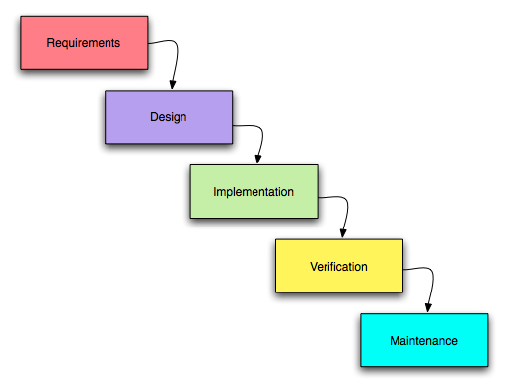
Waterfall Model
需求
设计
实现
确认
维护

Slide 7
Waterfall and reality
In fact, lack of interaction is not practical, and never was.
  Much has been written criticizing the waterfall model, but in fact the original authors never excluded interaction.
  It is a useful model, because it clearly defines a sequence of events that is contractually verifiable and legally defensible, analogous to a large civil engineering project.
事实上，缺乏互动是不现实的，从来都不是。
有很多人批评瀑布模型，但实际上，最初的作者从未排除交互。
它是一个有用的模型，因为它清楚地定义了一系列事件，这些事件在合同上是可验证的，在法律上是可辩护的，类似于大型土木工程项目。

Slide 8
Waterfall in Software and Classic engineering
The problem is that software projects are never as well understood as classic engineering projects
For the purpose of this course, The deliverables of the project follow a waterfall like sequence, but within this frame, there is much scope for agile and iterative development.
We shall discuss all of this, but first the phases.
问题是软件项目从来没有像经典工程项目那样被很好地理解
对于本课程的目的，项目的可交付成果遵循瀑布式的顺序，但是在这个框架中，敏捷agile和迭代开发的范围很大。
我们将讨论所有这些，但首先是各个阶段。

Slide 9
Discovery, planning, and risk
Discovery: This involves understanding thoroughly the problem, and reaching a clear agreement with the client on the deliverables. This starts with the domain model.
The layout of the process requires careful planning, and the plan of attack will depend on how confident the development team is on the product design, and the tools to be used in the project.
发现:这包括彻底理解问题，并与客户就可交付成果达成明确的协议。这从域模型开始。
流程的布局需要仔细规划，而攻击计划将取决于开发团队对产品设计和项目中使用的工具的信心。

Slide 10
Elements of the process
Domain Analysis
  "Domain Analysis“ is the investigation of the so-called "domain" of the software, i.e. the nature of the project and its environment.
  This involves an understanding of what is being said by the client experts in in terms of the domain's own terminology
  This phase is an important prelude to extracting and gathering the requirements, and creating a correct specification.
  This is the first phase of your project
“领域分析”是对软件所谓的“领域”的研究，即项目的性质及其环境。
这涉及到理解客户端专家根据领域自己的术语所说的内容
这个阶段是提取和收集需求以及创建正确规范的重要前奏。
这是项目的第一阶段

